Slide 1

Development of Computer System for Lexical & Morphological Analysis of Azerbaijani Language
Team members:
Fidan Aliyeva
Jalal Rasulzade
Nijat Mursali
Nargiz Huseynova
Team Advisor:
Dr. Samir Rustamov
Notes:
1.Cover page with project title, logo, graphics - Fidan

Slide 2
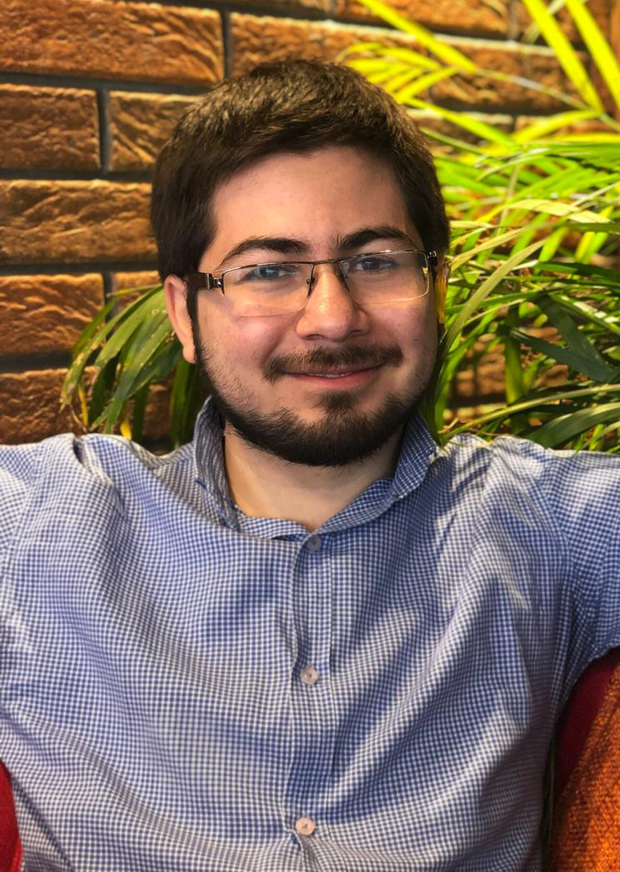
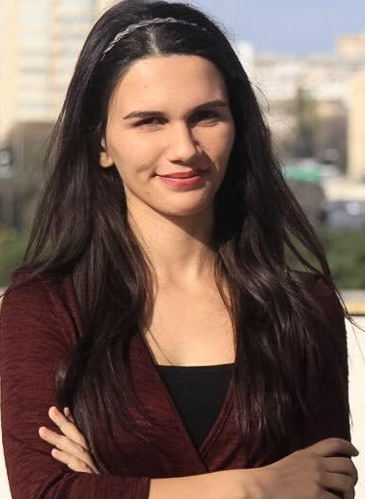
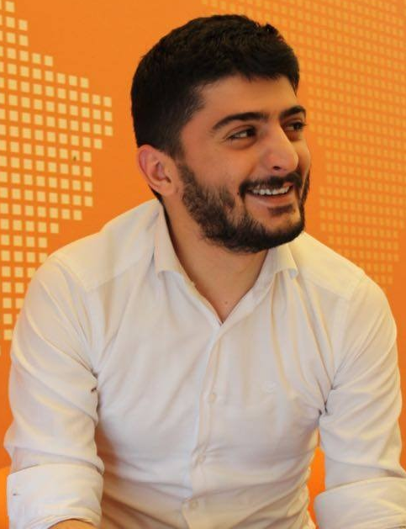
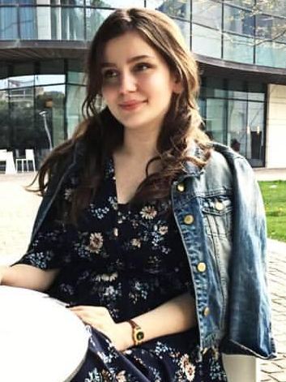
Team members and roles
Team Leader/Developer Text Analyst Data Engineer/ Text Analyst
Developer
Notes:
2.Team members, their responsibilities and roles, advisor, acknowledgments - Fidan

Slide 3
Motivation
Language is the most important attribute of a country
Lack of available modern language tools online
To make Azerbaijani language meet universal standards
Notes:
3.Motivation/Problem Statement - Fidan
/ Problem Statement

Slide 4
Problem Statement
Lack of tools
Complexity of Azerbaijani
Incorrect outputs due to exceptions –> “n” “y” “s”
Low response time

Slide 5

Research
+ Orthographic dictionary
= Our library
Books:
Buludxan Xelilov’s “Azərbaycan dilinin morfologiyası”
Buludxan Xelilov’s “Azərbaycan dili”
Mohsun Nagisoylu and Mehman Zeynalli’s “Azərbaycan dili”
Kamran Eliyev’s “Azərbaycan dili”
Q.Ş.Kazımov’s “Müasir Azərbaycan dili”
Elovset Abdullayev, Yusif Seyidov, Agamali Hesenov’s “Müasir Azərbaycan dili”

Slide 6
Singular or plural
6 cases of noun
Changing to subject/object
Possessive Cases
-am²(-yam²)
-san²
-dır⁴
-ık⁴(-yık²)
-sınız⁴
-dırlar⁴
-ım²(-m)
-ın⁴(-n)
-ı⁴(-sı⁴)
-mız⁴(-ımız⁴)
-nız⁴ (-ınız⁴)
-ları²
-ın⁴ (-nın⁴)
-a²(-ya²)
-ı⁴(-nı⁴)
-da²
-dan²
lar²
singular | “ata”
plural | “atalar”
Adlıq hal | “ata”
Yiyəlik hal | “atanın”
Yönlük hal | “ataya”
Təsirlik hal | “atanı”
Yerlik hal | “atada”
Çıxışlıq | “atadan”
I şəxs | “atayam”
II şəxs | “atasan”
III şəxs | “atadır”
I şəxs | “atayıq”
II şəxs | “atasınız”
III şəxs | “atadırlar”
I şəxs | “atam”
II şəxs | “atan”
III şəxs | “atası”
I şəxs | “atamız”
II şəxs | “atanız”
III şəxs | “ataları”

Slide 7
Compare
2018 ADA
STEMMING
2019 ADA
Morphological analysis
kitablarımdan
Kitab
Kitabça
lar
kitab
lar
ım
dan
kitab
ım
dan

Slide 8
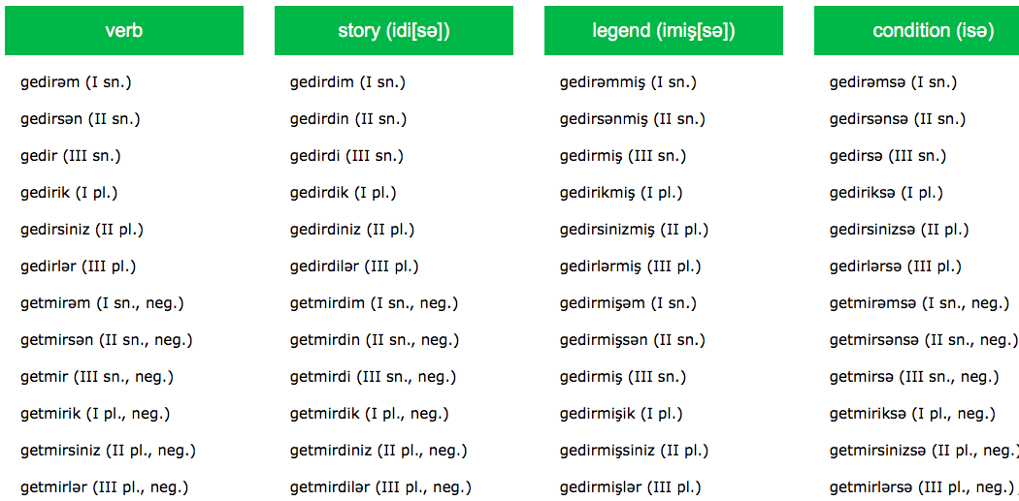
Research
Azeri NLP by Jafar Aliyev
http://nlp.jsoft.ws

Slide 9
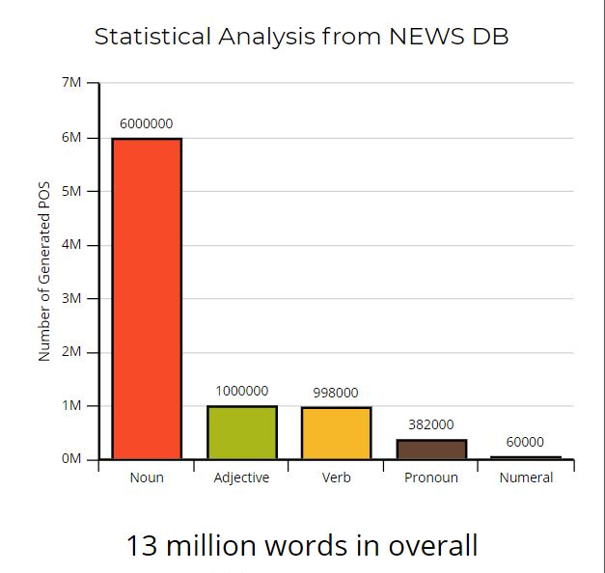
Research
Machine Learning Techniques
Natural Language Processing
Stemming and Lemmatization
Lovins Stemmer
Porters Stemmer
Levenshtein Algorithm
Data Cleaning
Resources from 85 thousand Azerbaijani news: NEWSDB
Cleaned data with more than 3 million sentences
Removed unnecessary elements from data such as duplicates
Notes:
nijat

Slide 10

Development Challenges
Methodology:
Rule-based methodology
utf-8, exFat/NTFS, Python 3.0+
Software:
Challenge:
Letters - ü ö ğ ı ə ç ş Solution: Python 3.6
Python is slow on Windows Solution: Ubuntu 14.04
Hardware:
HP Pavilion

Slide 11
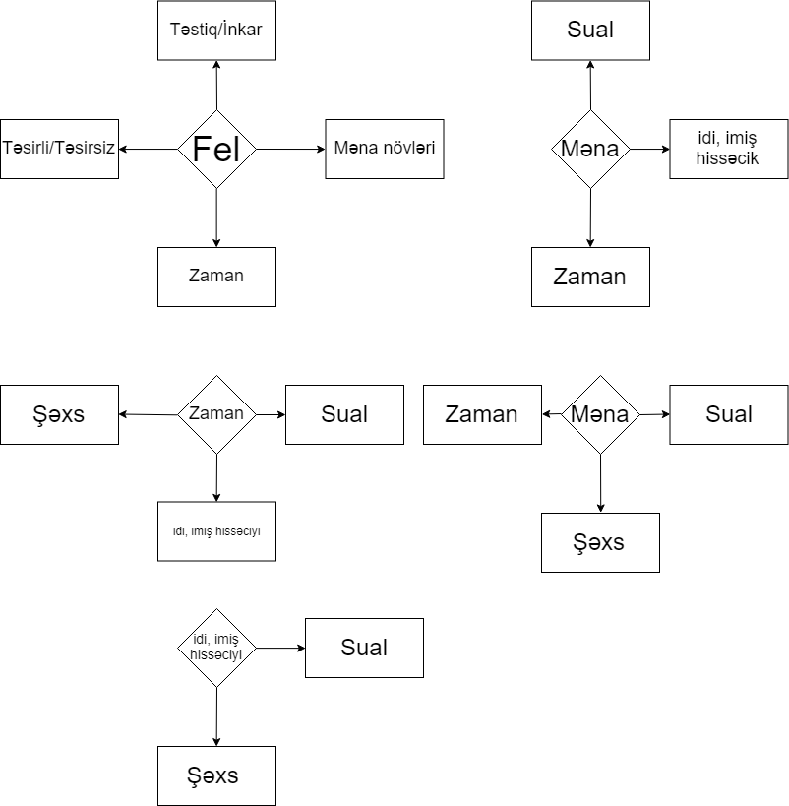
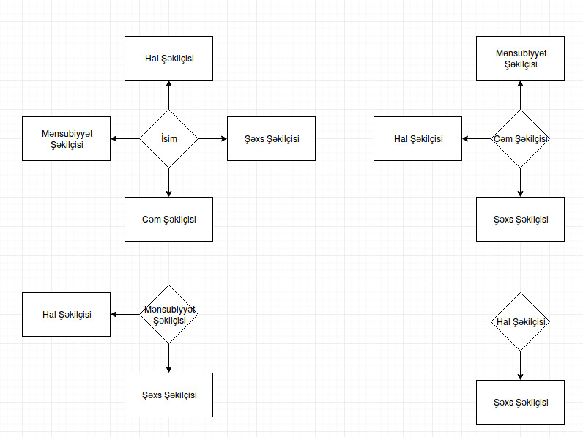
Flowchart

Slide 12
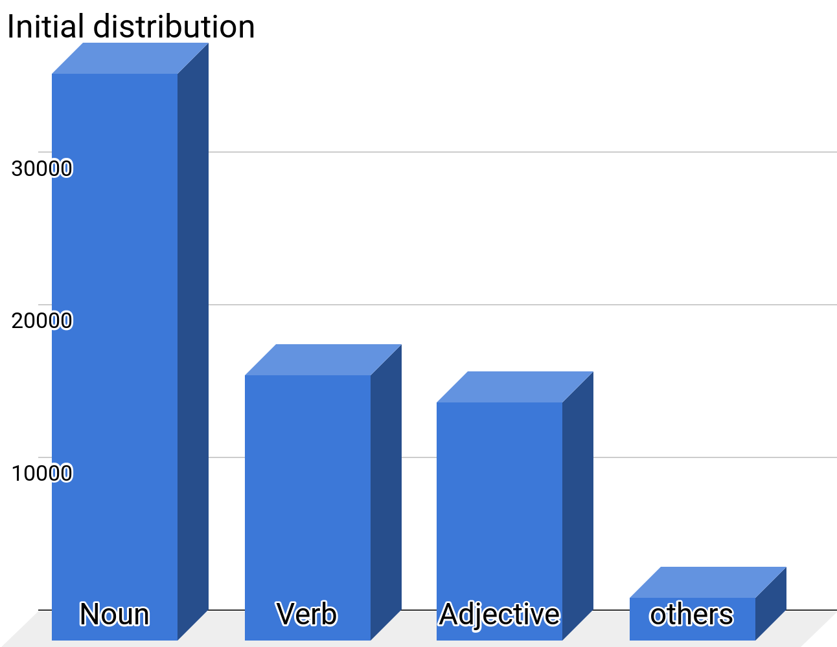
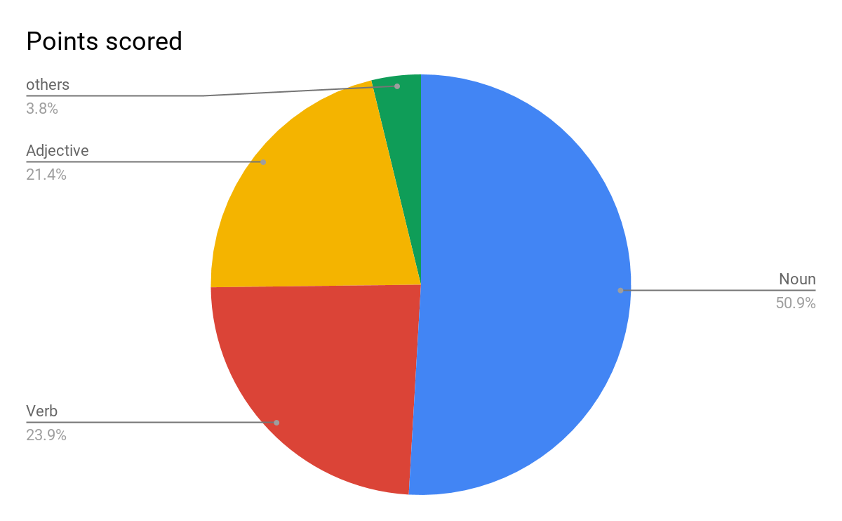
Statistics –Our Library 77,740 words

Slide 13
Statistics
Gedirəm
Gedirsən
Gedir
Gedirik
Gedirsiniz
Gedirlər
Gedərəm
Gedərsən
Gedər
Gedərik
Gedərsiniz
Gedərlər
...
...
Getməliyəm
Getməlisən
Getməlidi
Getməliyik
...
...
...
Kitablar
Kitabın
Kitaba
Kitabı
Kitabda
Kitabdan
Kitabım
Kitabın
Kitabı
Kitabımız
...
...
...
...
Kitablarımdan
Kitablarından
Kıtablarımızdan
...
...
Kitab (Noun)
Get
(Verb)
More than 300
forms
More than 700
forms

Slide 14
Statistics
Total 745.454 sentence
Total 13 mln words from NEWSDB
Generated more than 27 mln words from library

Slide 15
Statistics
Data taken from NEWSDB
33%
names
Names
Abbreviations
Misspelled Words
Proper Nouns
&Not Recognized Words
13 MILLION WORDS
67%
Generally used words

Slide 16
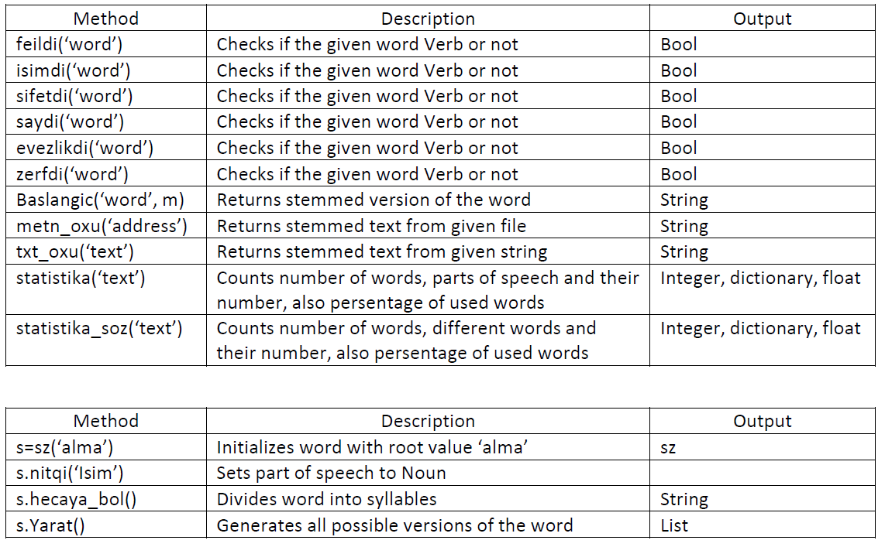
Diagram / Architecture / Model

Slide 17
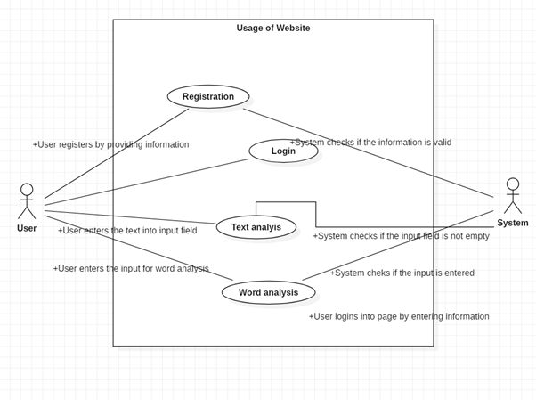
Prototype / Model developed in the framework of the project
http://lingvistika.ml
Package soz_analysis
https://github.com/nijatmursali/SDPIIWebsite

Slide 18
Social Impact
Help to researchers and developers for further language analysis tool developments
Benefit the students in their studies

Slide 19
Future Work
Increasing word capacity of our dictionary
Adding additional labels to words
Foreign origin words
Alive or inanimate
Objects

Slide 20
References
Xelilov, Buludxan. “Azərbaycan dilinin morfologiyası”
http://buludxan-xelilov.com/pdf/azerb-dilininin-morfologiyasi-I-hisse.pdf
Xelilov, Buludxan, “Azərbaycan dili”
http://www.buludxan-xelilov.com/pdf/sintaksise%20girish%2003.07.2017-A4.pdf
Nagisoylu, Mohsun. And Zeynalli, Mehman. “Azərbaycan dili”
http://www.anl.az/el/Kitab/252289.pdf
Eliyev, Kamran, “Azərbaycan dili”
http://elibrary.bsu.az/books/N_2246.pdf
Q.S.Kazimov, “Müasir Azərbaycan dili”
https://aclweb.org/anthology/P99-1037
Jafar Aliyev - Azeri NLP
http://nlp.jsoft.ws
Working Prototype
http://lingvistika.ml
Source code of WebPage
https://github.com/nijatmursali/SDPIIWebsite
Source code of library
https://github.com/Djooonni/soz_analizi

